Slide 1
Distributed Denial of Service (DDoS) Attacks
Jonny (Jianhua) Yu, Alice (Yee Sin) Yu
Department of Computer Systems Technology
Vancouver Community College
CSTP 2106: Intro to Computer Security
Professor Rahim Virani
December 5, 2025

Slide 2

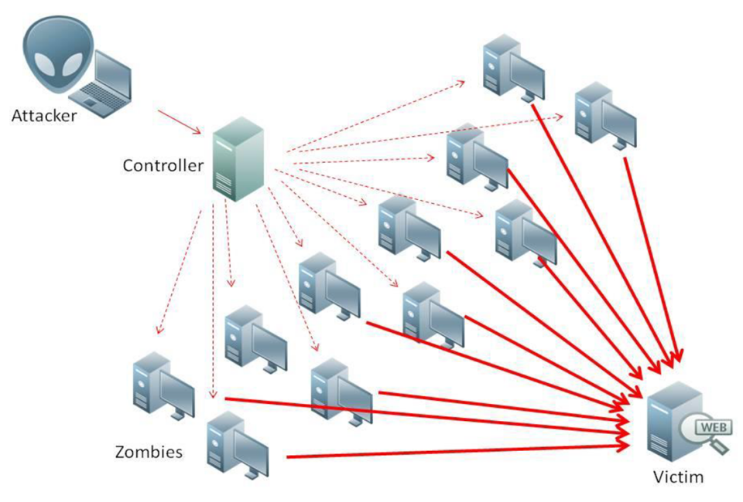
What is DDOS attacks
DDoS uses a large amount of traffic to flood websites and networks

Slide 3
What is DDOS attacks
Growing impact on global cybersecurity

Slide 4
Why DDoS Matters in Computer Security
A DDoS attack targets mainly the “availability” by overloading a system and preventing real users from accessing services
Confidentiality
DDoS
Integrity
Availability

Slide 5
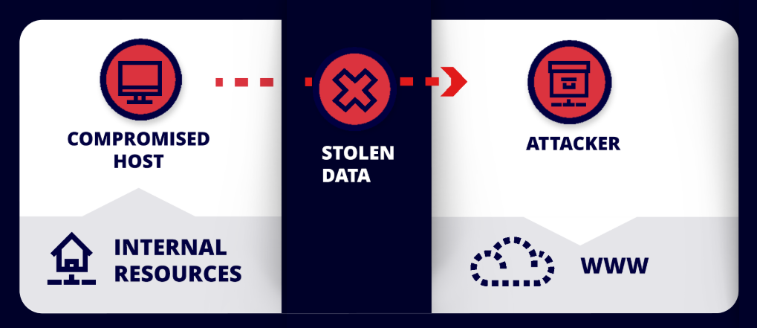
Why DDoS Matters in Computer Security
Attackers often use DDoS attacks as a smokescreen to hide other malicious activities, such as installing malware or exfiltrating data

Slide 6
Types of DDoS Attacks
Volumetric (Layer3): DNS amplification, UDP floods
Protocol (Layer4): SYN floods
Application (Layer7): HTTP floods, SQL injection

Slide 7
Industry Threats & Impacts
Gaming industry: 49%
Government agencies: 19%
Tech & cloud providers: 15%
Financial sector: 12%
Rise of ransom DDoS

Slide 8

Growing Complexity of Attacks
Attackers use adaptive, multi-vector methods
AI-assisted attack patterns
Real-time evasion of detection systems

Slide 9
Project Demonstration Setup
VMs: Kali (attacker), Xubuntu (victim) & Ubuntu (observer, optional)
Apache2 web server as target environment

Slide 10
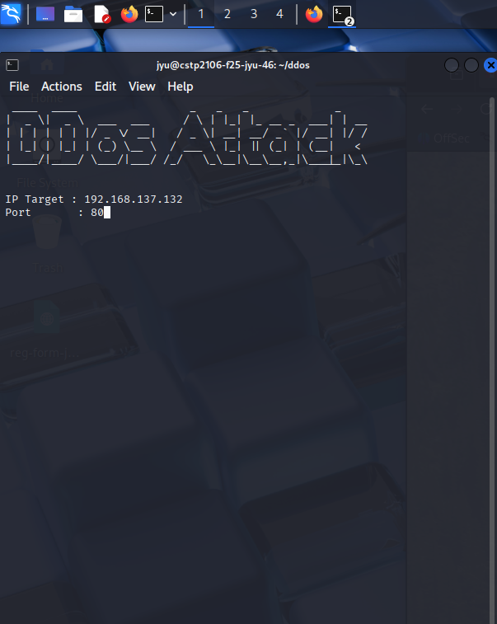
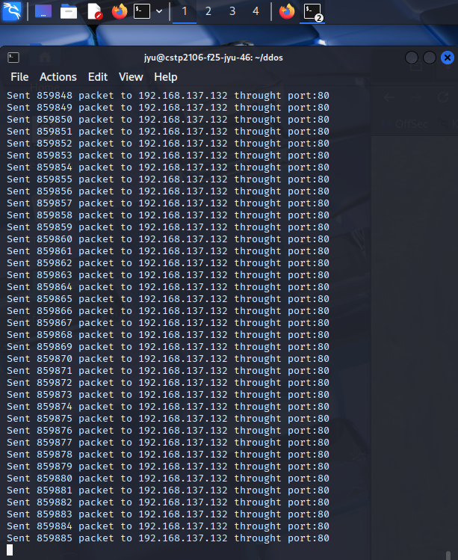
DDoS Attack Tools
Python DDoS script simulating traffic floods

Slide 11
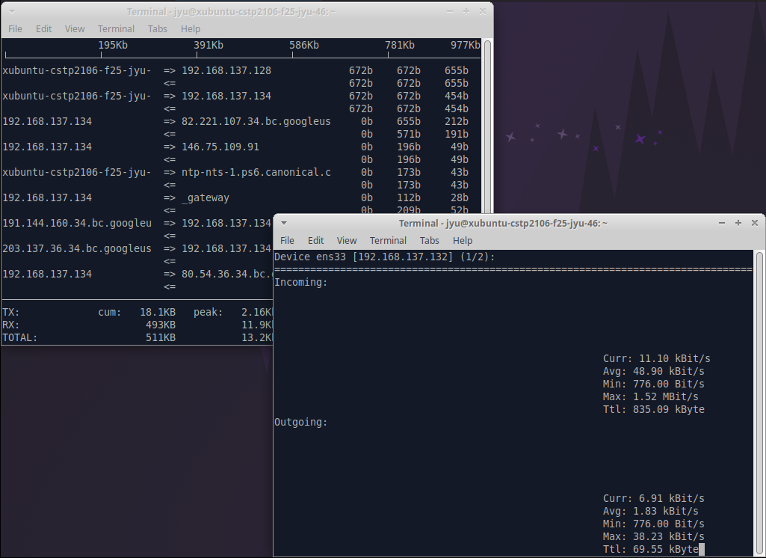
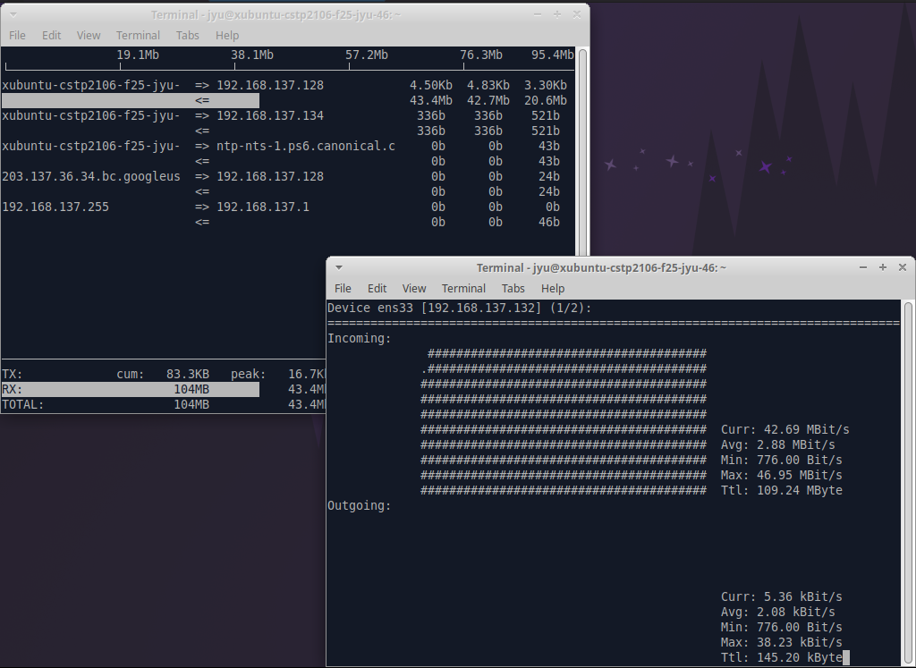
DDoS Monitoring Tools
Monitoring: iftop, nload
Before attack
After attack

Slide 12
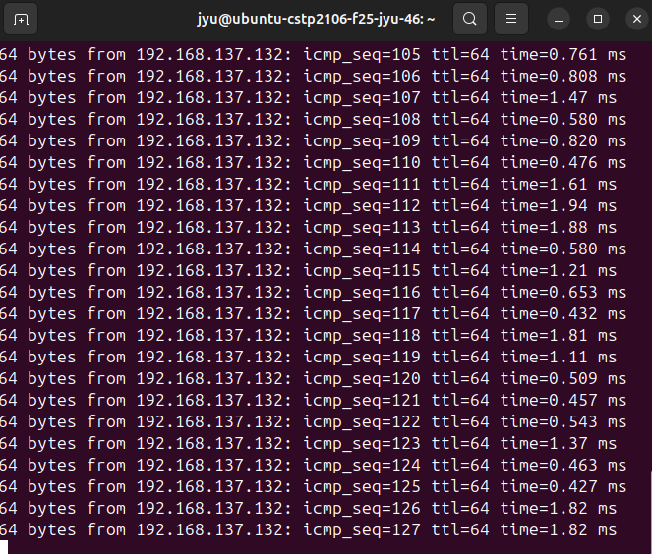
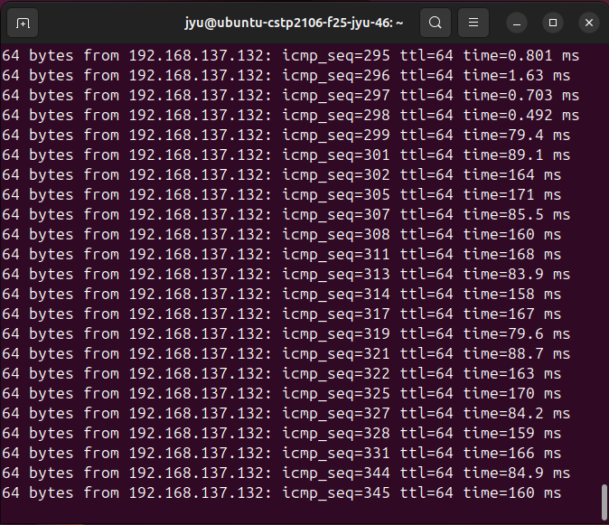
Observer Monitor
Before attack
After attack

Slide 13
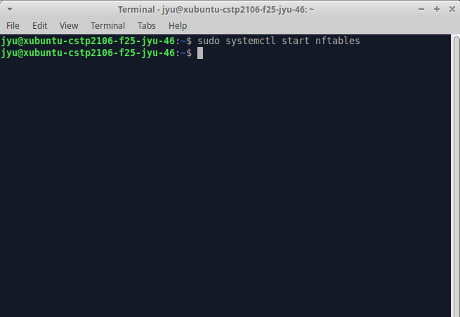
DDoS Defensive Tools
nftables for firewall rules

Slide 14
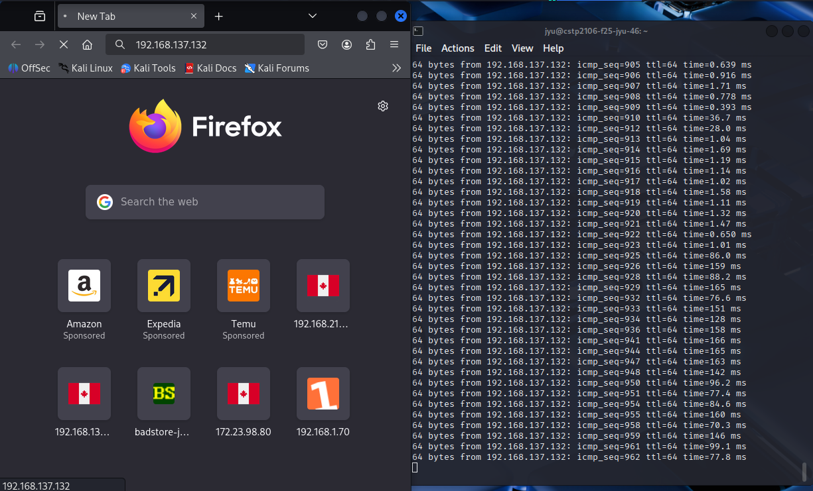
DDoS Defensive Tools
After nftables defense

Slide 15
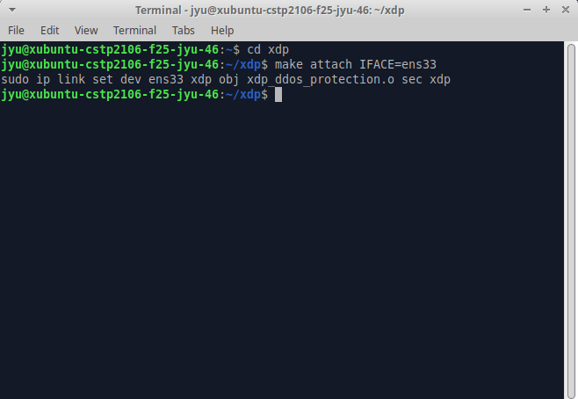
DDoS Defensive Tools
XDP (early packet filtering)

Slide 16
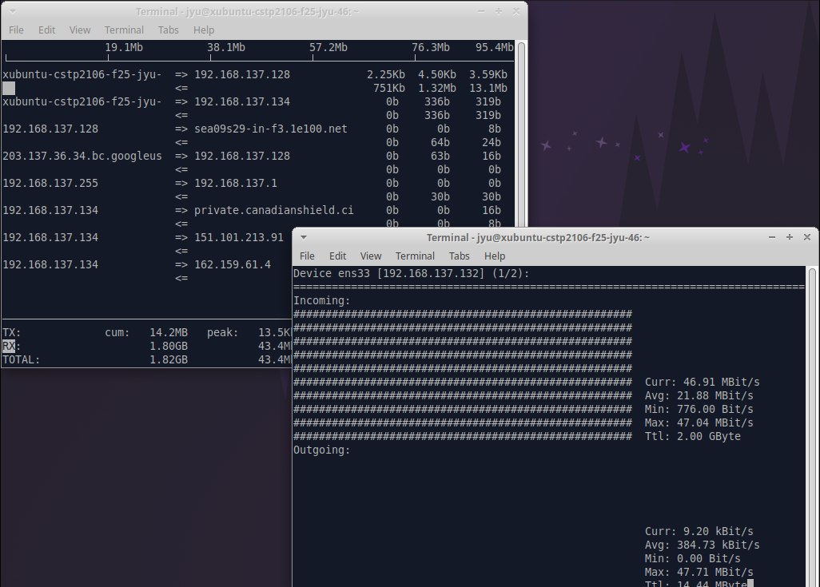
DDoS Defensive Tools
After XDP defense

Slide 17

Conclusion
Deepened understanding of DDoS mechanisms
Hands-on tools reinforced theoretical concepts
Challenges led to valuable learning
Problem-solving and analysis skills improved

Slide 18
Thank you!

